Slide 1
SC-400 Exam
26-50
Without Answers

Slide 2
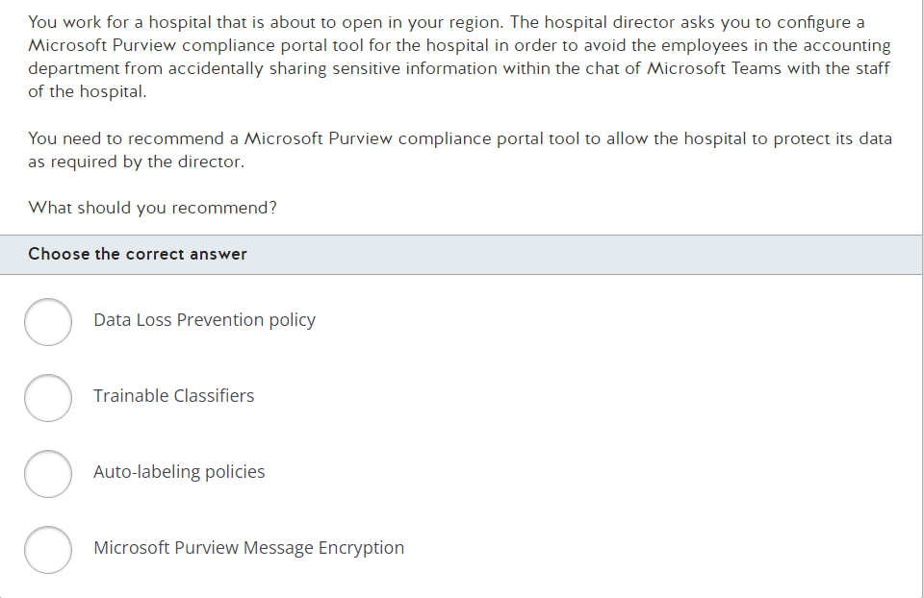

Slide 3
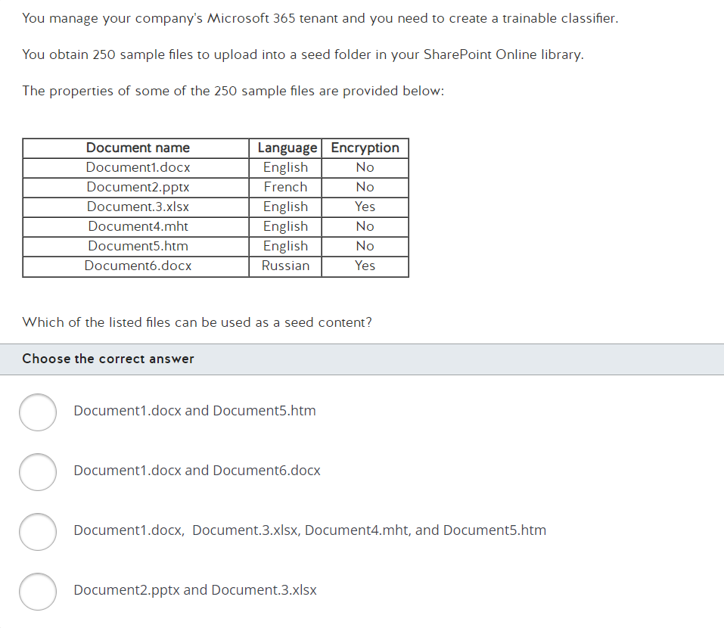

Slide 4
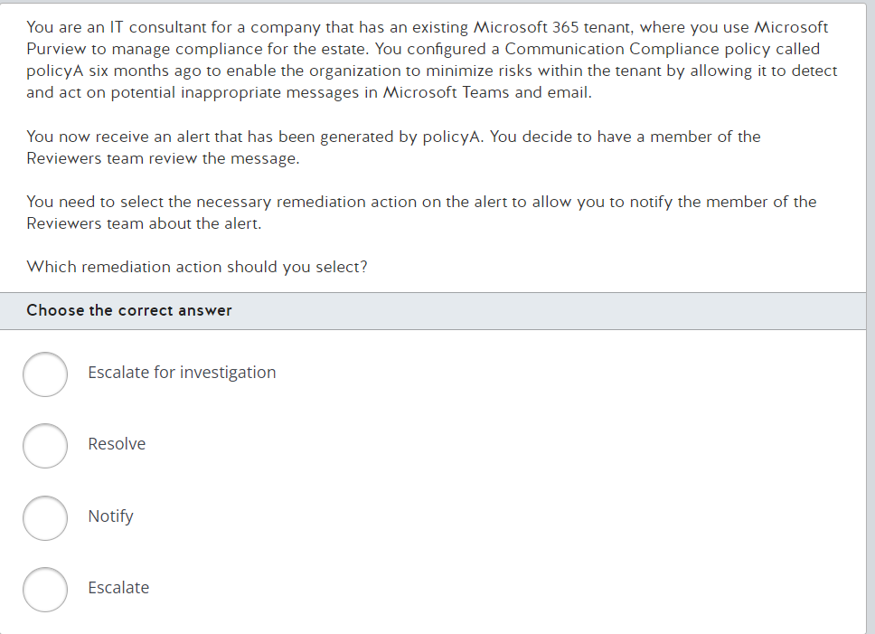

Slide 5
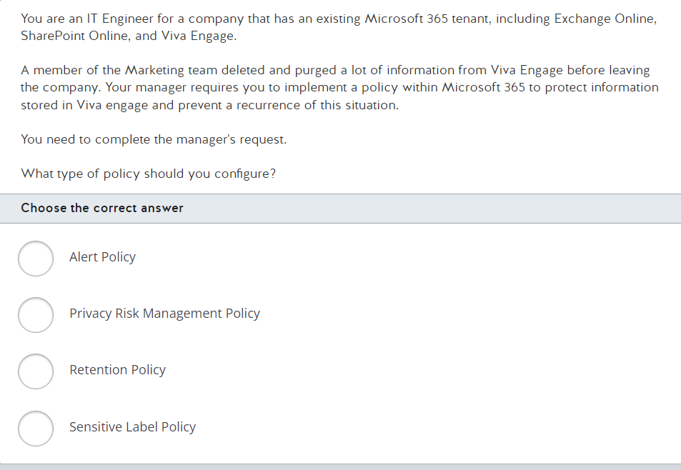

Slide 6
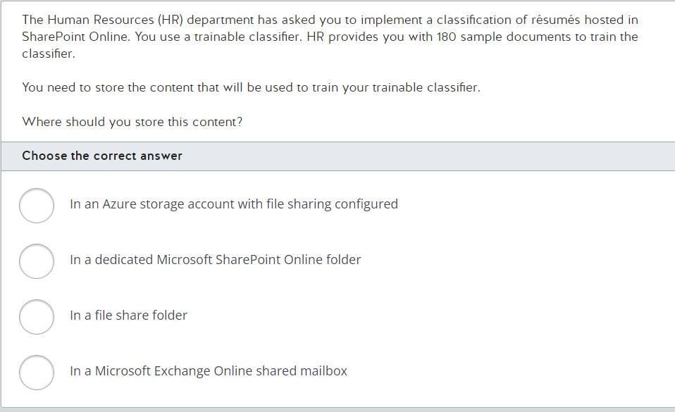

Slide 7
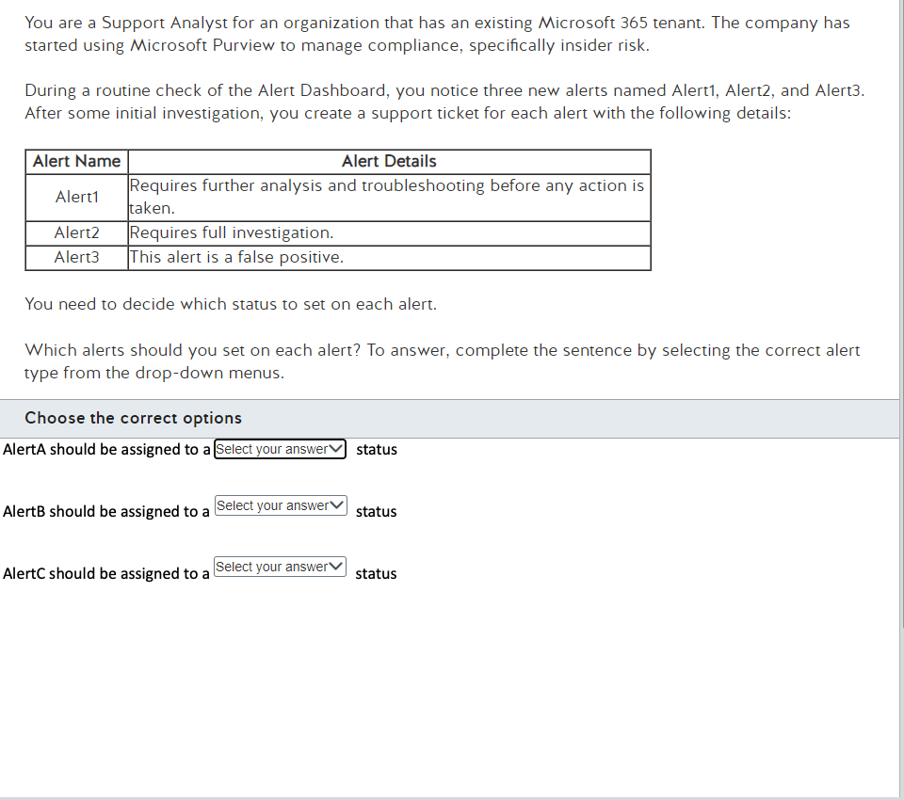
Confirmed
Dismissed
Needs Review
Resolved
Confirmed
Dismissed
Needs Review
Resolved
Confirmed
Dismissed
Needs Review
Resolved

Slide 8
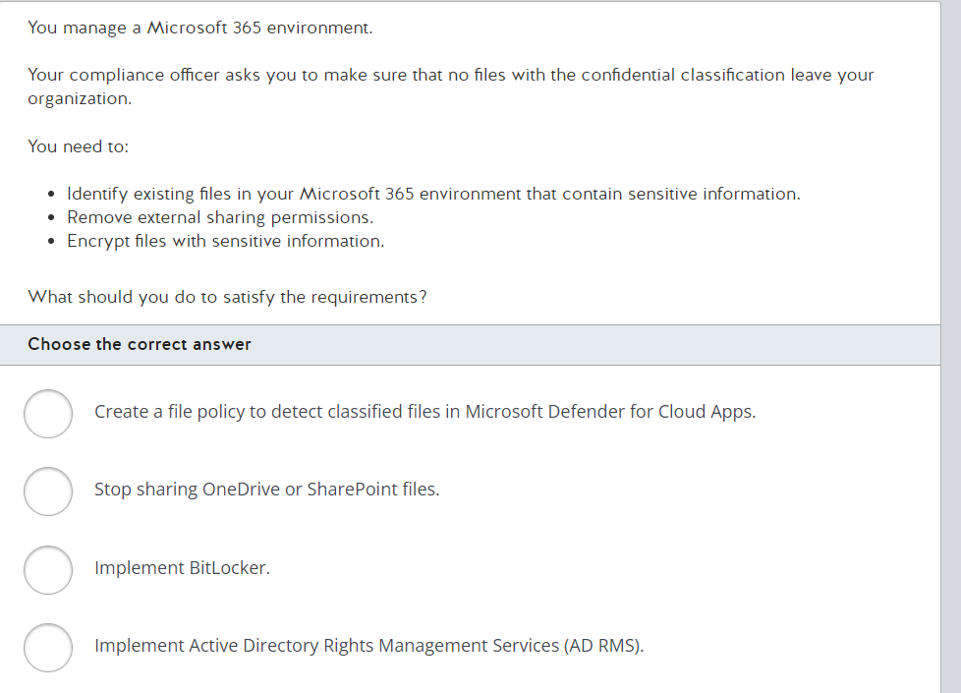

Slide 9
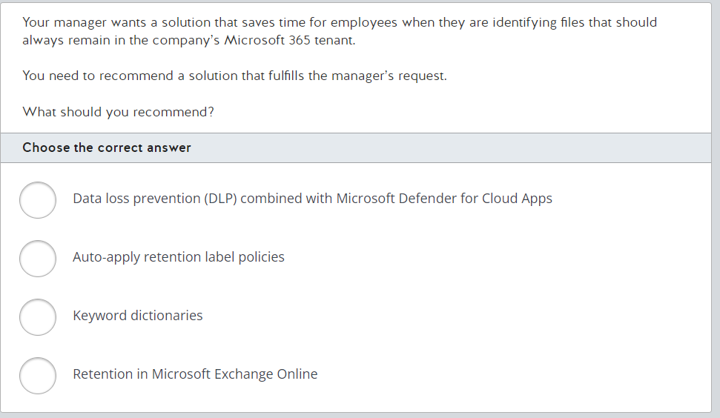

Slide 10
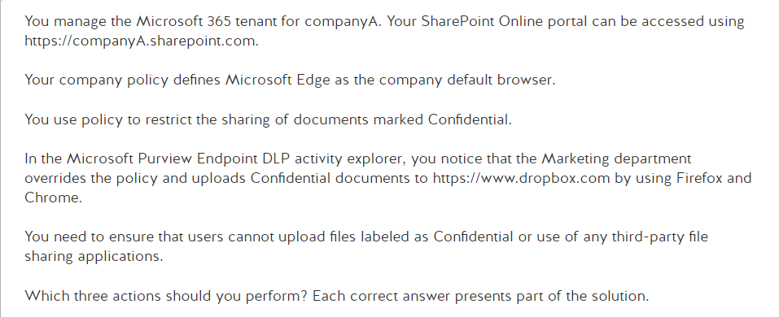
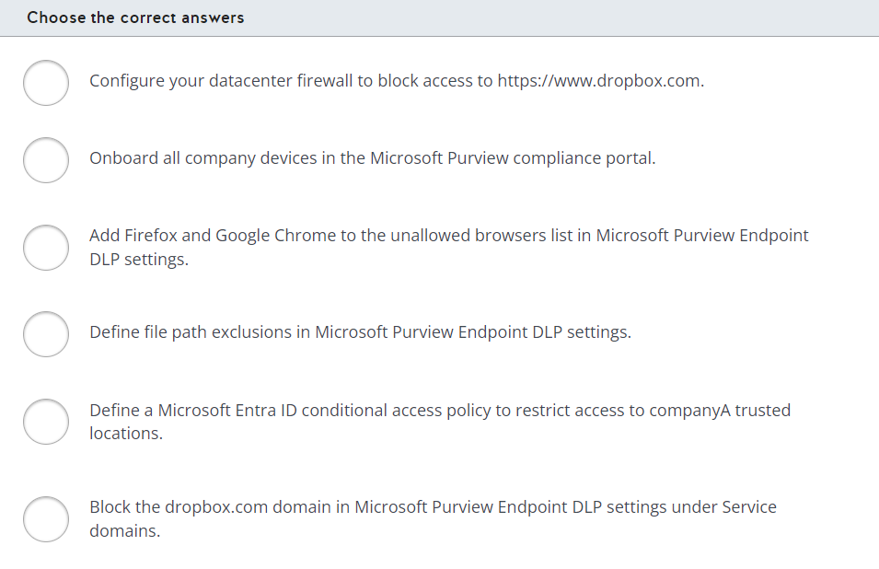

Slide 11
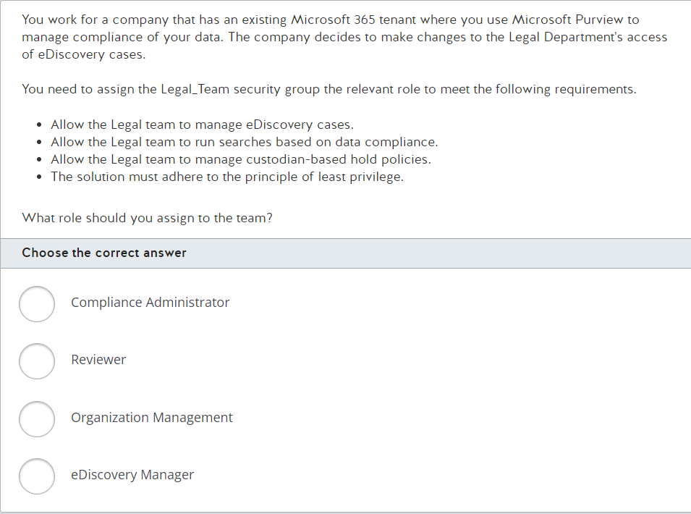

Slide 12
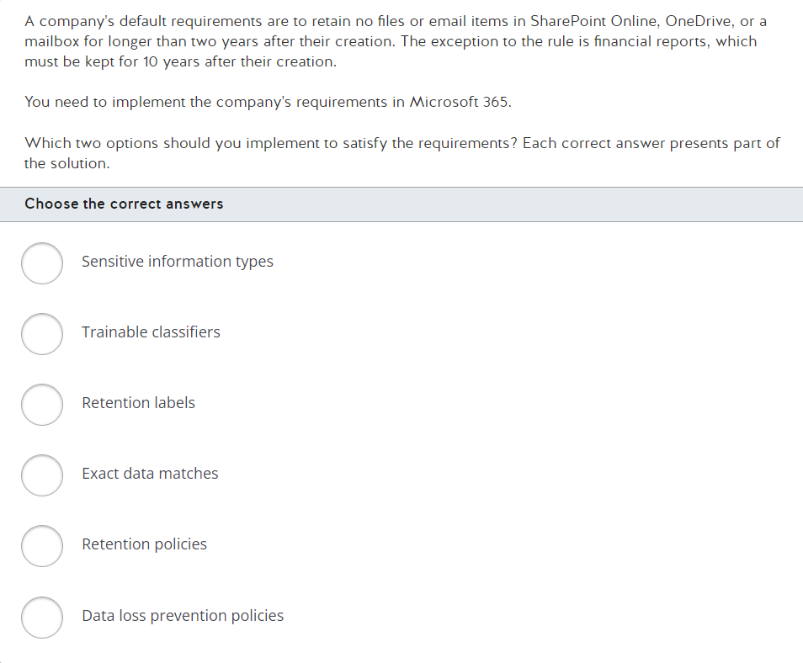

Slide 13
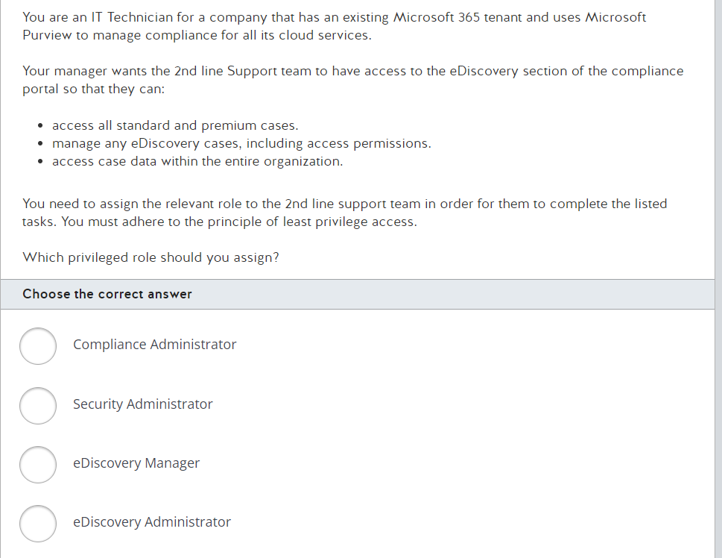

Slide 14
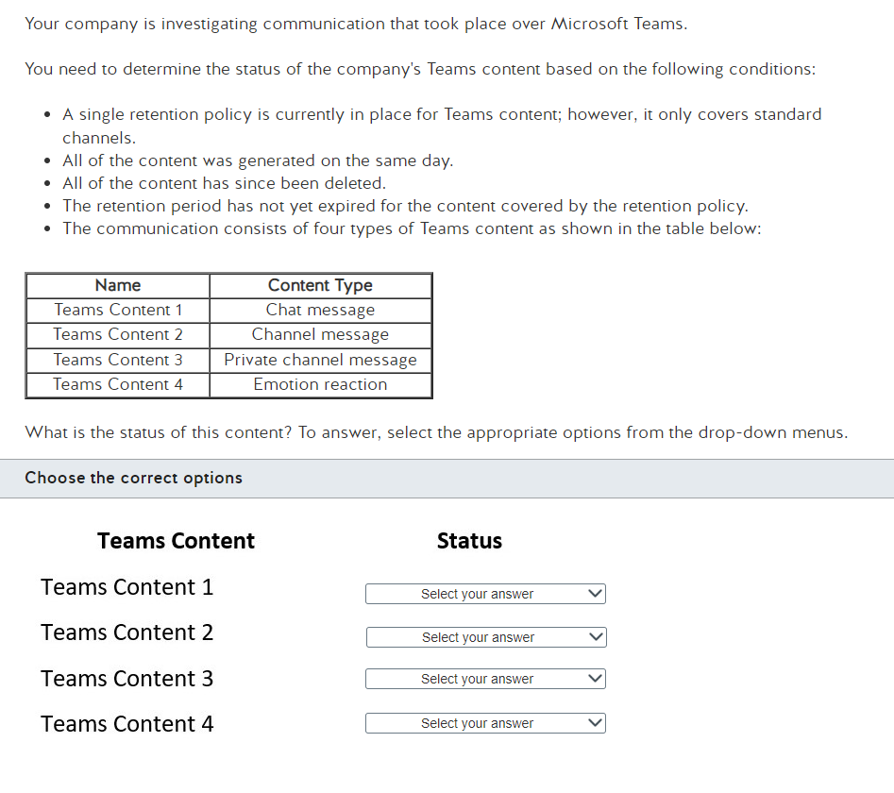
Held in SubstrateHolds Folder
Permanently Deleted
Held in SubstrateHolds Folder
Permanently Deleted
Held in SubstrateHolds Folder
Permanently Deleted
Held in SubstrateHolds Folder
Permanently Deleted

Slide 15
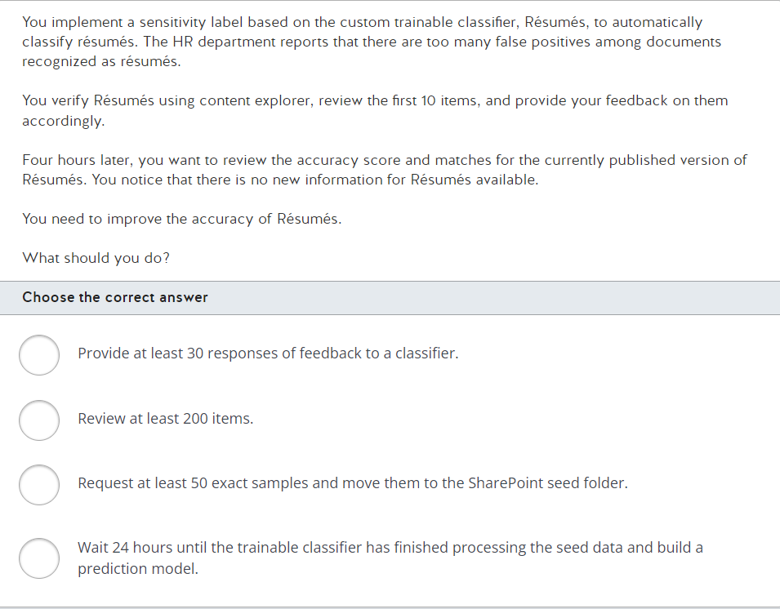

Slide 16
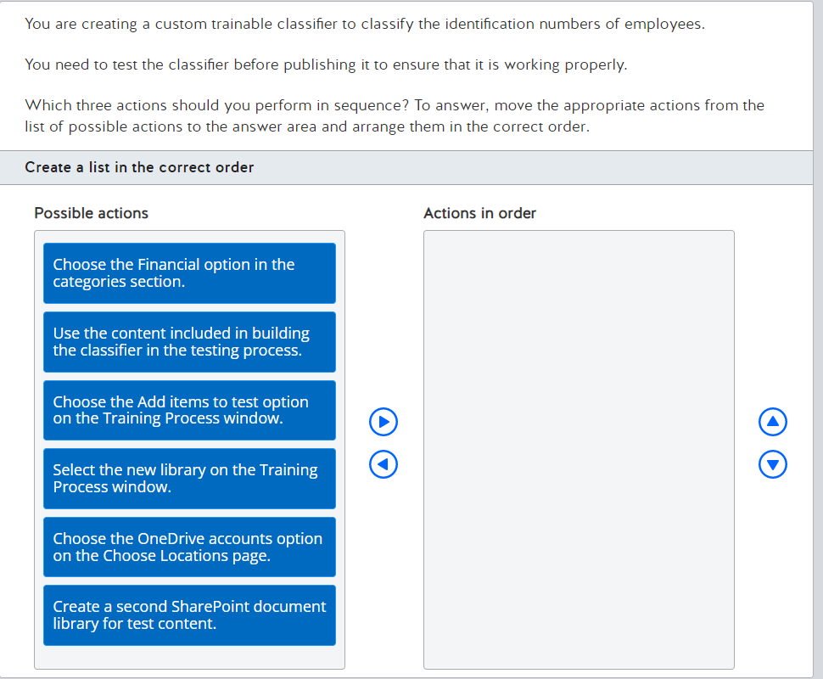

Slide 17
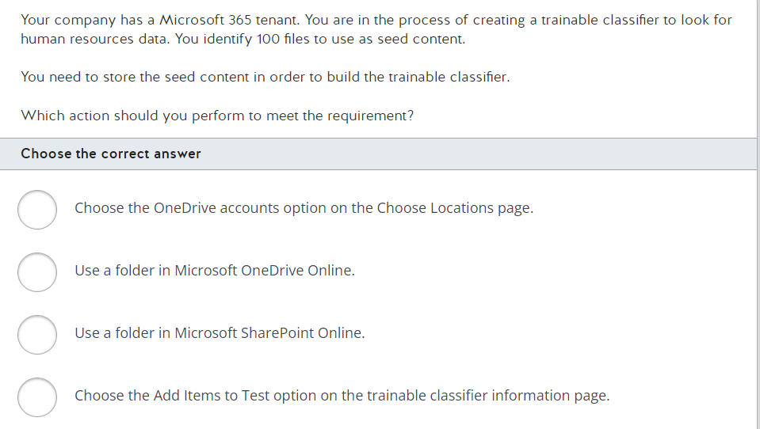

Slide 18
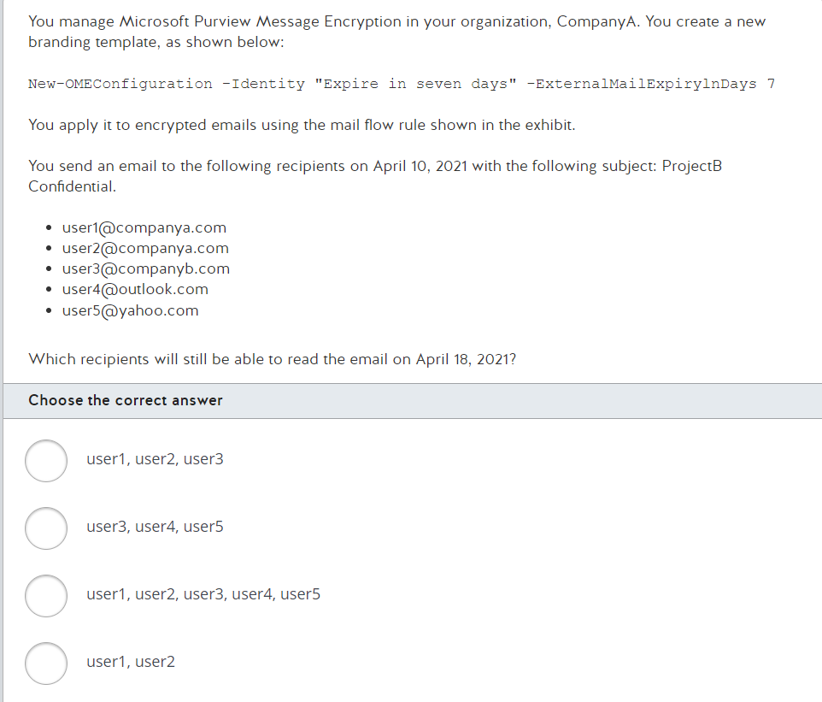
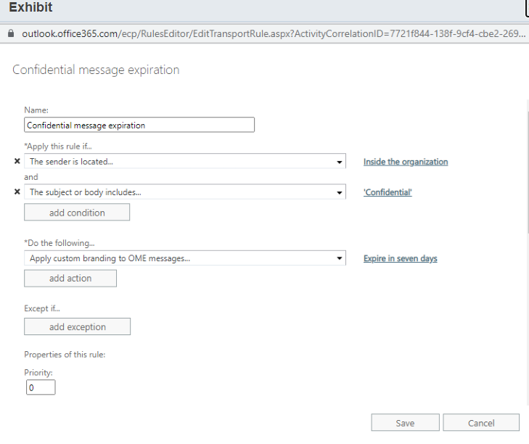

Slide 19
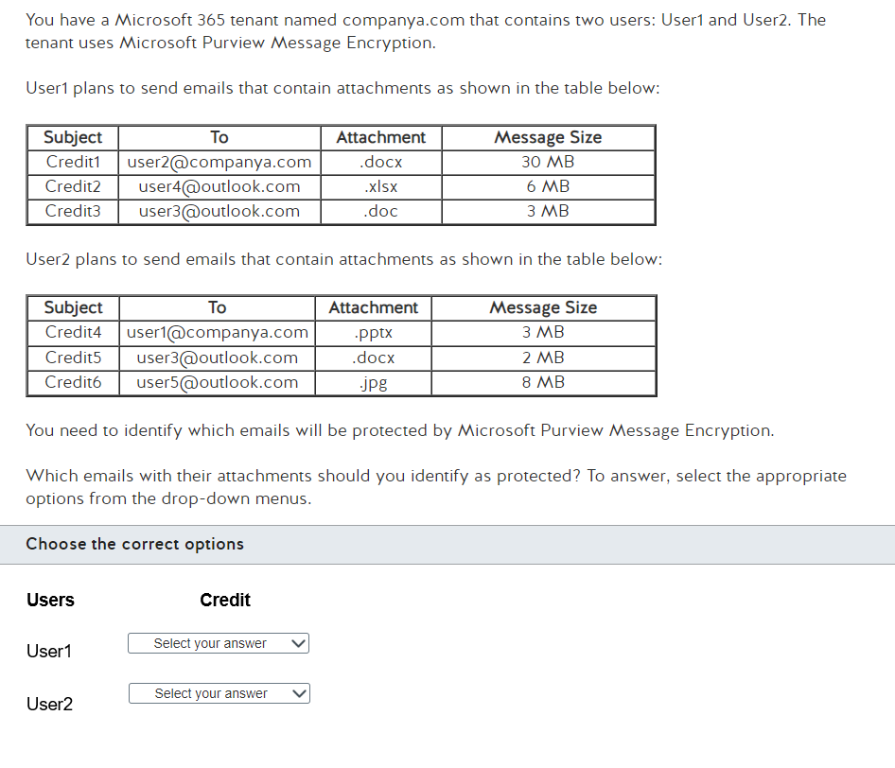
Credit 1 only
Credit 2 only
Credit 2 and 3 only
Credit 6 only
Credit 4 and 5 only
Credit 5 and 6 only

Slide 20
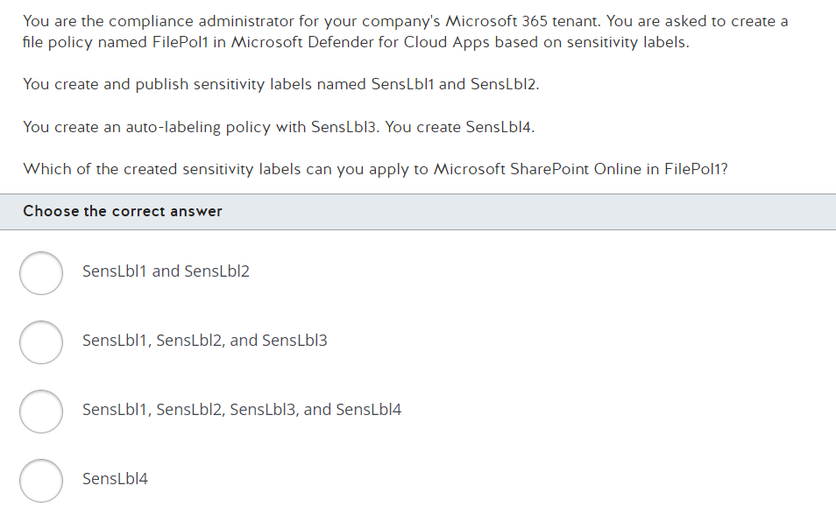

Slide 21
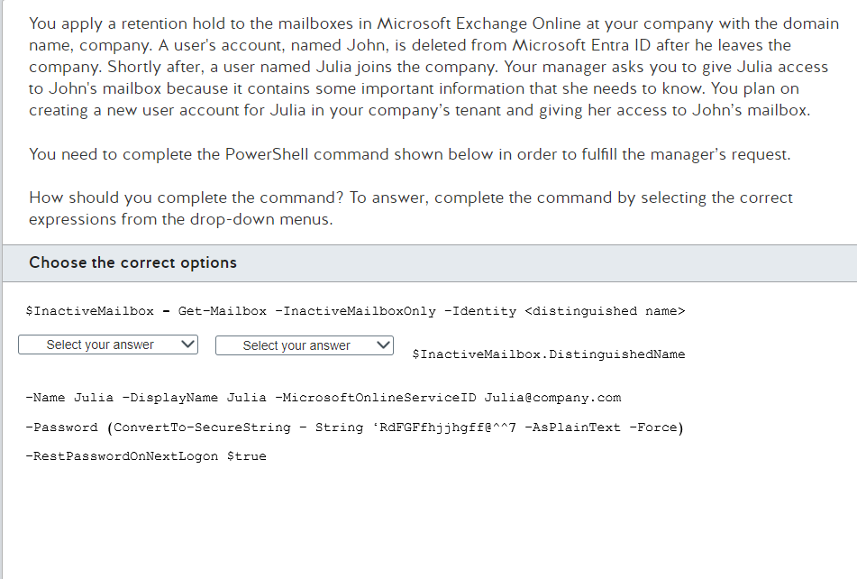
New-MailboxRestoreRequest
New-Mailbox
Set-Mailbox
-inactivemailbox
-LitigationHoldEnabled
-RetentionHoldEnabled

Slide 22
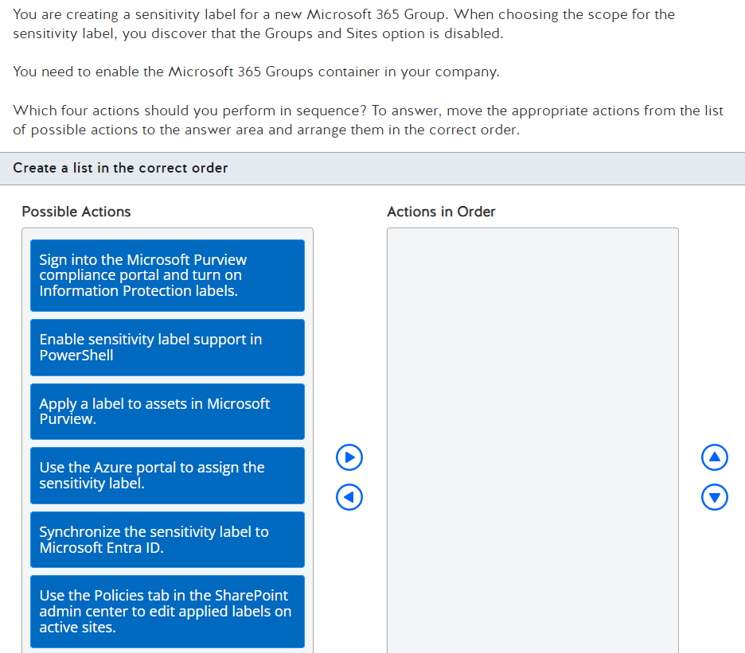
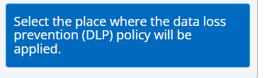

Slide 23
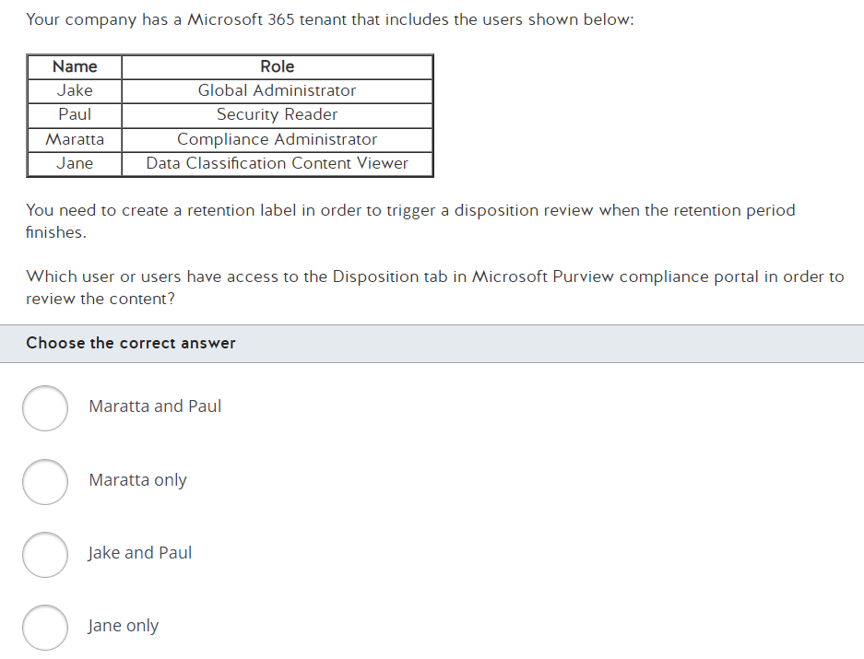

Slide 24
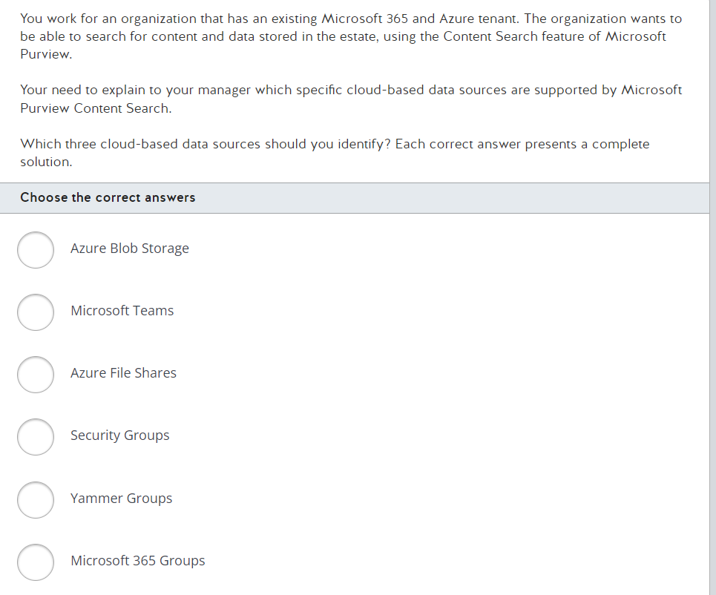

Slide 25
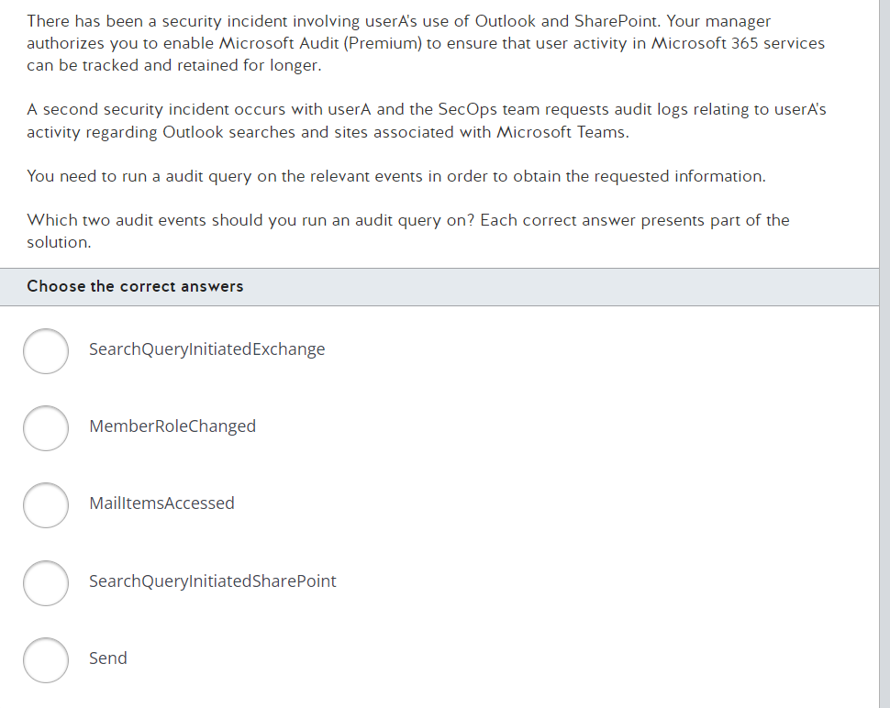

Slide 26
